Slide 1
ELICA DISPLAY PROGRAM
2023

Slide 2
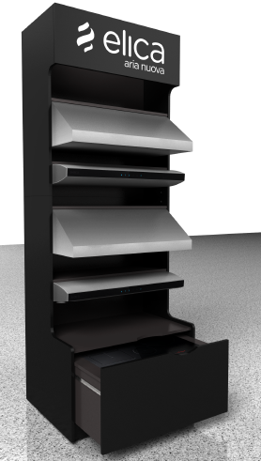
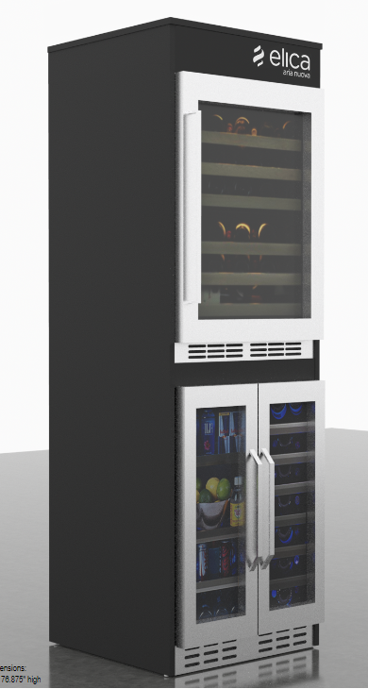
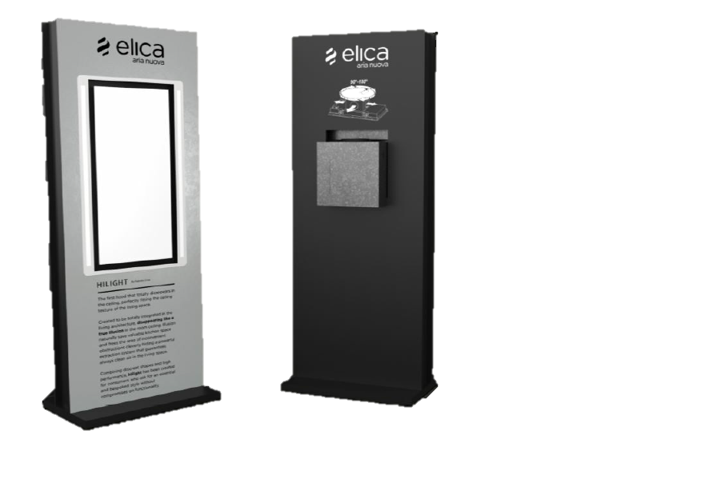
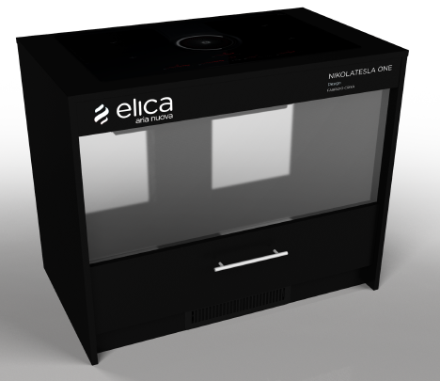

DISPLAY PROGRAM 2023 | AVAILABLE MODELS
UPRIGHT DISPLAYS
#EXXUPDB2
UCR DISPLAY
#EXXBLUCR
NIKOLATESLA DISPLAYS
#EXXNTDBL
CEILING DISPLAYS
#EXXCSDBL-ILLUSION
#EXXCSDBL-HILIGHT
NEW
½” Wider
OPEN ORDERS
Notes:
We are going to send a small survey to each one to know how many you have and how many you will be needing.

Slide 3
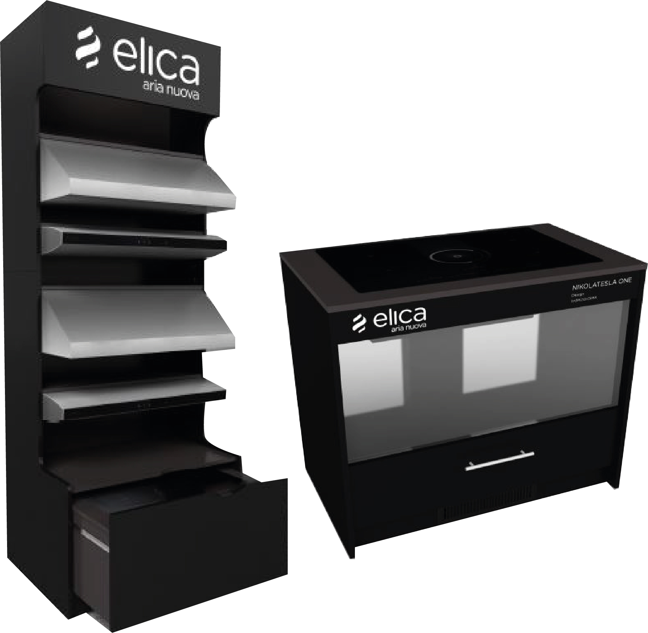
DISPLAY PROGRAM 2023 | UPRIGHT DISPLAY
13 ¾”
1
CODE #EXXUPDB2
Display Material
¾ Black and D91 Slate Gray Double sided Thermal Formed Laminate over high density particle board with matching edge band
79 ¾”
4
66”
Dimensions
2
39 1/2” Wide
28 3/4” Deep
103 1/2” High
23 ¾”
*The four mounting shelves for the hoods are adjustable in increments of 1 3/8 in.
3

Slide 4
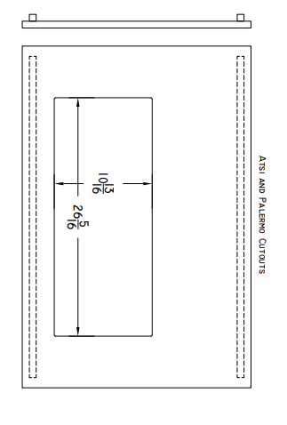
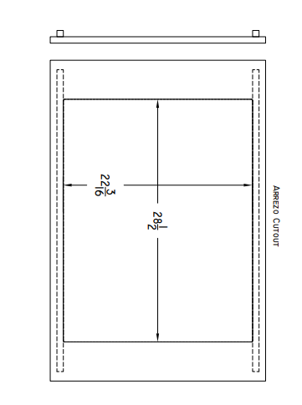
DISPLAY PROGRAM 2023 | UPRIGHT DISPLAY
Cut out dimenssion:
Cut out in drawer top is 26 5/16” W x 10 13/16”D for Asti and Palermo.
A bigger cutout for Arezzo can be made with the marked cutout.
Cutout is positioned so that Hood is toward the front of the drawer.

Slide 5
DISPLAY PROGRAM 2023 | UPRIGHT DISPLAY
Installation
The models to be placed on the upper part must be 36 in wide models
The recomended quantity for the display on the upper part is 3, another model can be added but it will affect visibility
Details
Two 3” locking and 3” non- locking casters are included
The display will be shipped assembled in two sections
The final assembly step requires the joining of the two sections with two mini fix connections at the final destination
The two sections will be packaged together in corrugate sleeves on a 44” x 62” pallet
Installation Instructions
https://elicacom-my.sharepoint.com/:b:/g/personal/j_lluhi_elica_com/ESjl4Zmmtm5JjneNytguBJYB4P_Z0t4oLQtZ0xNWGDP_4A?e=aTwlae

Slide 6
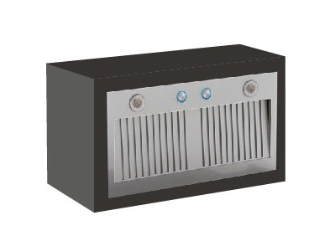
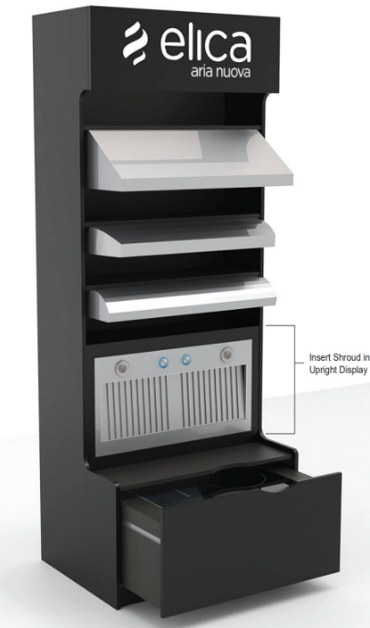
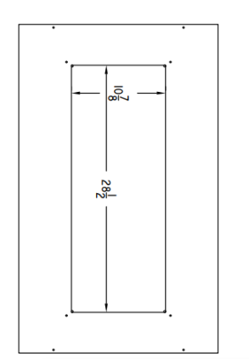
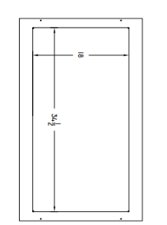
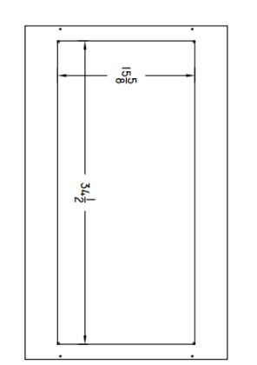
DISPLAY PROGRAM 2023 | INSERT BOX ACCESSORY FOR #EXXUPDBL
CODE #EXXINPBL – Asti / Palermo
#EXXINSBL – Scanno
#EXXINTBL - Trento
Dimensions
37 15/16” W x 12” D x 23” H
Installation Instructions
https://elicacom-my.sharepoint.com/:b:/g/personal/j_lluhi_elica_com/EeXkBoGPP55Il-AH0MAXTiABVh-NP4XWr8RCxo0LLNk6Ww?e=jIaycs
#EXXINPBL – Asti / Palermo
#EXXINTBL – Trento
#EXXINSBL – Scanno

Slide 7
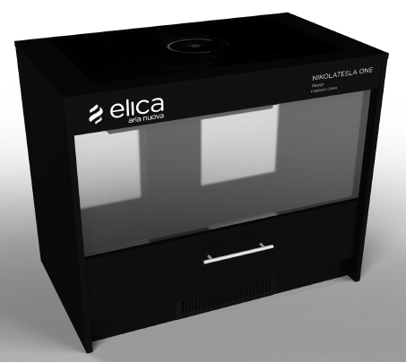
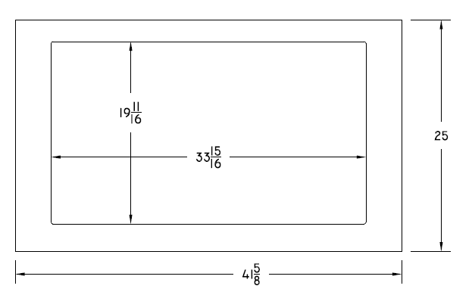
DISPLAY PROGRAM 2023 | NIKOLA TESLA DISPLAY
CODE #EXXNTDBL
45.1” W x 25” D x 36” High
Dimensions
Install Instructions
https://elicacom-my.sharepoint.com/:b:/g/personal/j_lluhi_elica_com/EeNUmFFeGzxHr6eFddRhe0kBxOWDFOr1k-Aih5LWH_cfMQ?e=4Jws61
Cut out dimensions for cooktop

Slide 8
DISPLAY PROGRAM 2023 | CEILING DISPLAY
CODE #EXXCSDBL - ILLUSION
#EXXCSDBL - HILIGHT
29.5” W x 20” D x 78.75” High
Dimensions
Install Instructions
https://elicacom-my.sharepoint.com/:b:/g/personal/j_lluhi_elica_com/EaIg6FWoAxVEouuwYTpHJGoBu_kt2b3fPtv26J9L89skJw?e=Q2sxBa

Slide 9
DISPLAY PROGRAM 2023 | UCR DISPLAY
CODE #EXXBLUCR
23.5” W x 24” D x 77” High
Dimensions
Install Instructions
https://elicacom-my.sharepoint.com/:b:/g/personal/j_lluhi_elica_com/EcoOydmOLF1JrUQEcnrFTfIBEhumEFGIO1-Kc2E-J1huuQ?e=Ldxl13
Details
It fits the 4 different RISERVA Series Models:
  EBF52SS1
  EWS52SS1
  EBS52SS1
  EBS51SS1

Slide 10
THANK YOU

